Slide 1

Unit 2
Inheritance
By. Dr. Amit.

Slide 2
Inheritance
To inherit a class, we simply incorporate the definition of one class into another by using the extends keyword.
The general form of a class declaration that inherits a superclass is shown here:
class subclass-name extends superclass-name {
// body of class
}
You can only specify one superclass for any subclass that you create.
Java does not support the inheritance of multiple super classes into a single subclass.
You can, as stated, create a hierarchy of inheritance in which a subclass becomes a superclass of another subclass. However, no class can be a superclass of itself.

Slide 3
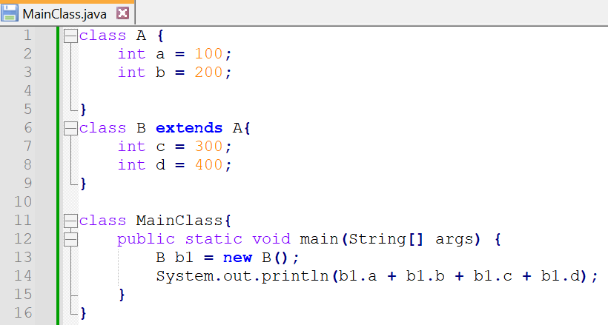
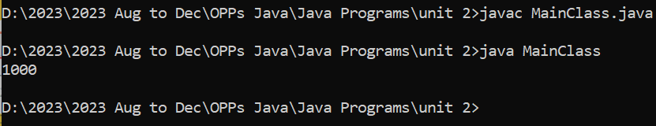

Slide 4
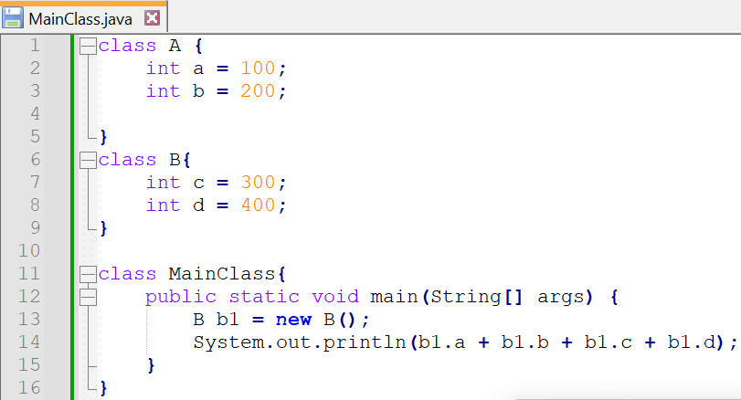
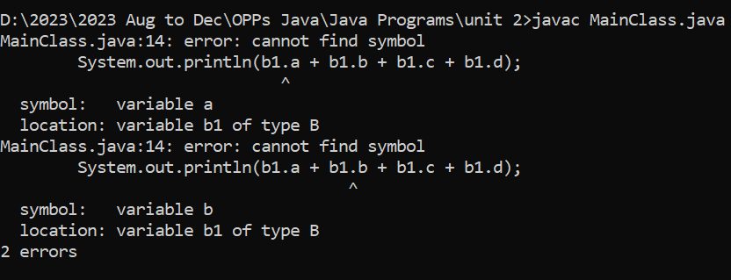

Slide 5
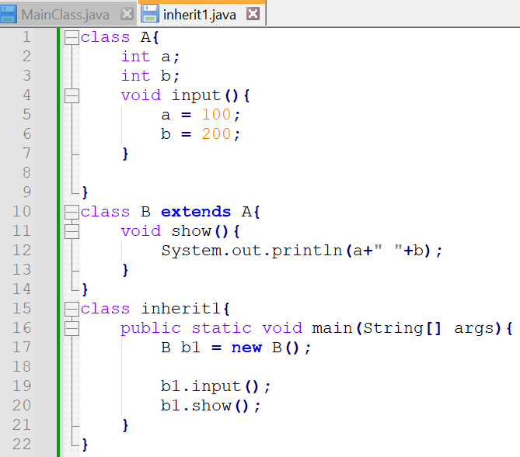
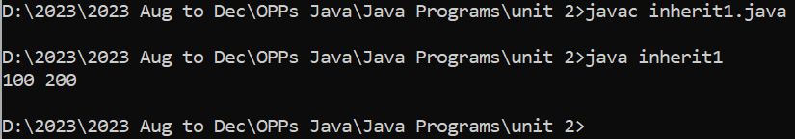

Slide 6
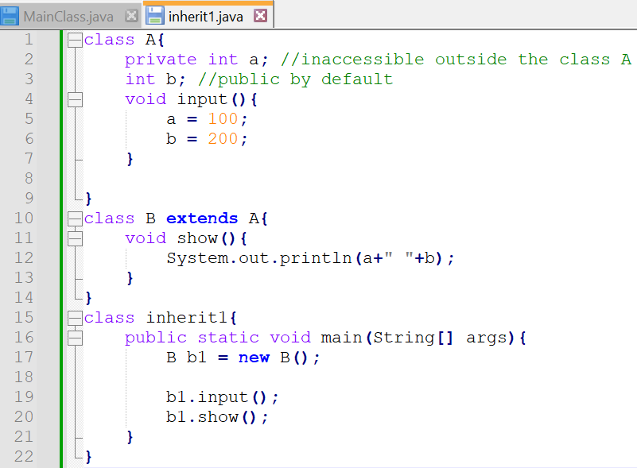
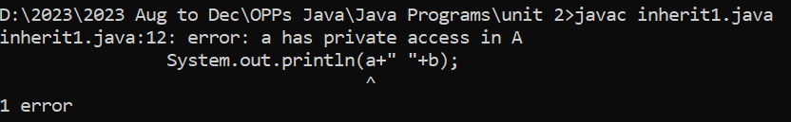
Member Access and Inheritance
Although a subclass includes all of the members of its superclass, it cannot access those members of the superclass that have been declared as private.

Slide 7
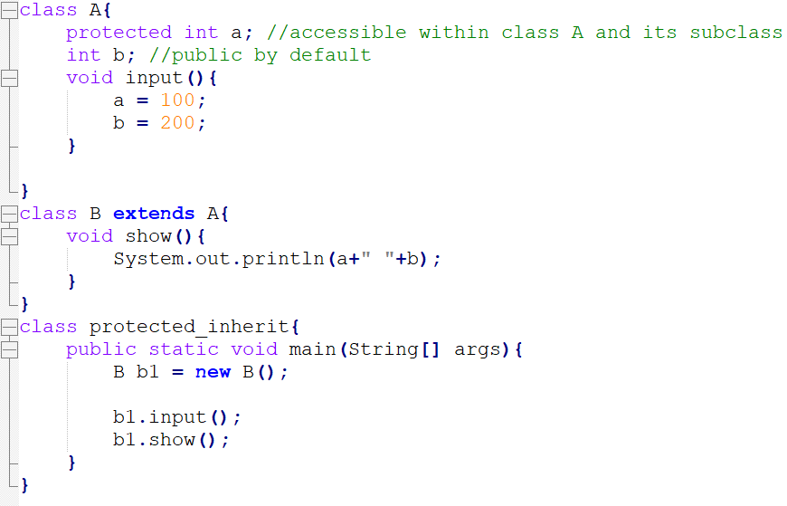
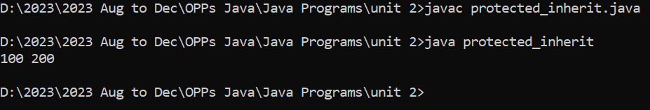
Member Access and Inheritance
Protected: Accessible in class, subclass, and in same package.

Slide 8
Constructor
A constructor is a special type of method that is used to initialize objects when they are created.
Constructors have the same name as the class they belong to and do not have a return type, not even void.
They are called automatically when an object of the class is instantiated using the new keyword.
Default Constructor (No-Argument Constructor):
Automatically provided by the Java compiler if a class does not explicitly define any constructors.
This default constructor takes no arguments and initializes the object's fields to default values, which are typically 0 for numeric types and null for reference types.

Slide 9
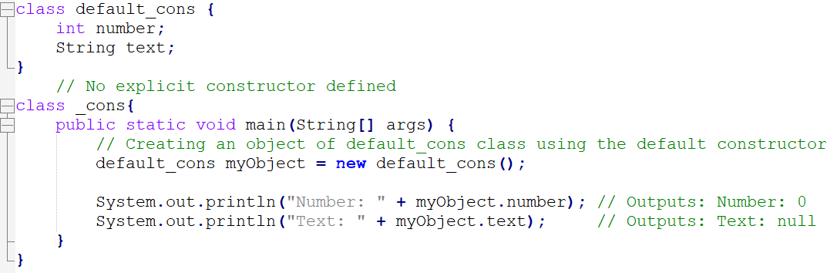
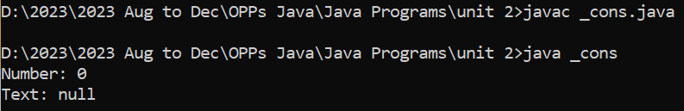

Slide 10
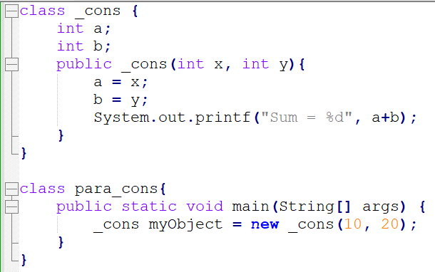
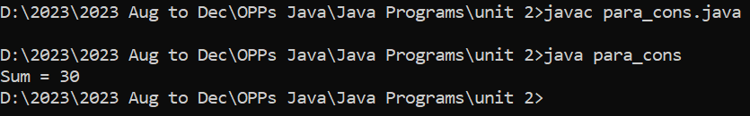
Parameterized Constructor:
A parameterized constructor accepts one or more parameters to initialize an object with specific values.
It allows you to set custom values during object creation.

Slide 11
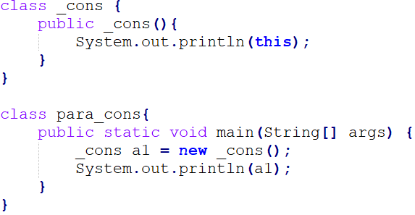
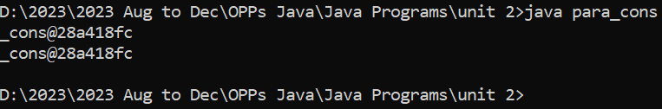
this keyword:
The this keyword is a reference to the current instance of the class in which it is used..
"_cons": This is the name of the class to which the object belongs, in this case, the _cons class.
"@": This is a separator symbol that separates the class name from the hexadecimal representation of the hash code.
"28a418fc": This is the hexadecimal representation of the hash code of the object. This value is unique for each instance of the class in a particular run of the program but may not be unique across different program runs.

Slide 12
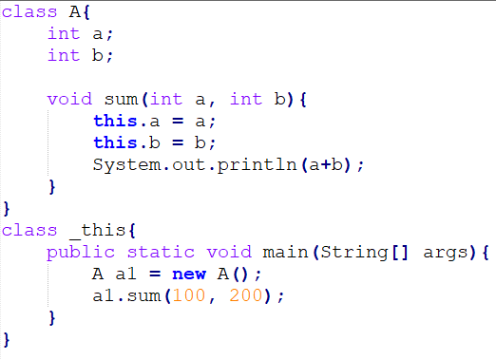
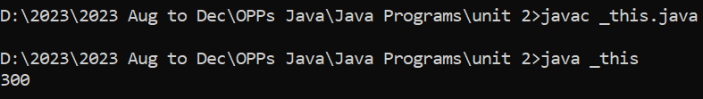
this keyword Example:
To Distinguish Between Class Members and Method Parameters.

Slide 13
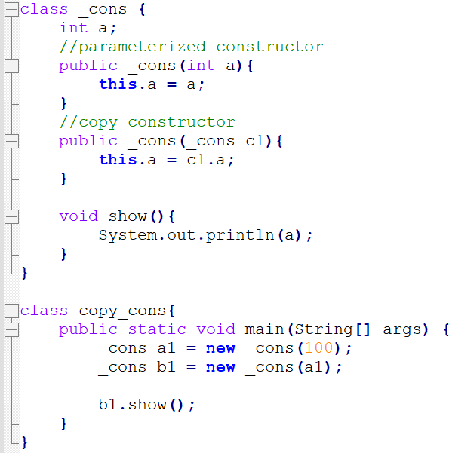
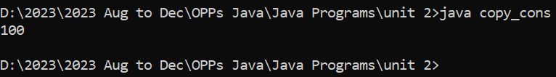
Copy Constructor:
A copy constructor creates a new object by copying the values from another object of the same class.
It is useful for creating a new object with the same characteristics as an existing one.

Slide 14
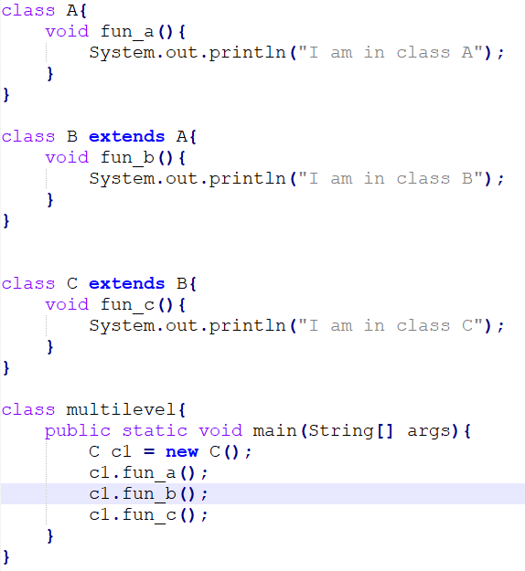
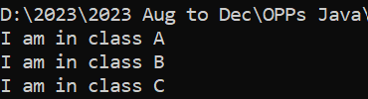
Multi-level Inheritance
- A class inherits from a class that has already inherited from another class.

Slide 15
What is super keyword in java and what are its use ?
Whenever a subclass needs to refer to its immediate superclass, it can do so by use of the keyword super.
To access a member of the superclass that has been hidden by a member of a subclass. That is when a subclass has its own member with the same name as a member in the superclass.
To call the superclass constructor.

Slide 16
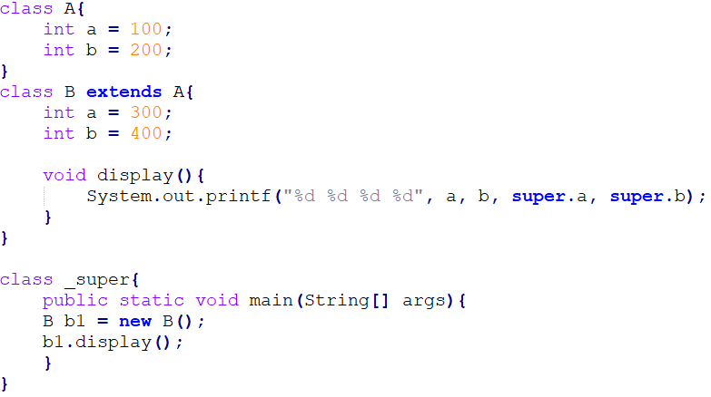
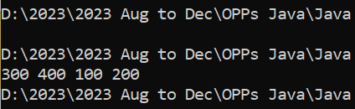
To access a member of the superclass that has been hidden by a member of a subclass. That is when a subclass has its own member with the same name as a member in the superclass.

Slide 17
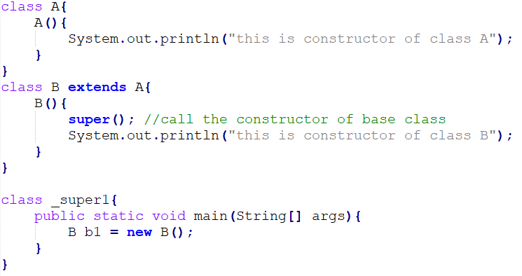
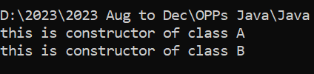
To call the superclass constructor.

Slide 18
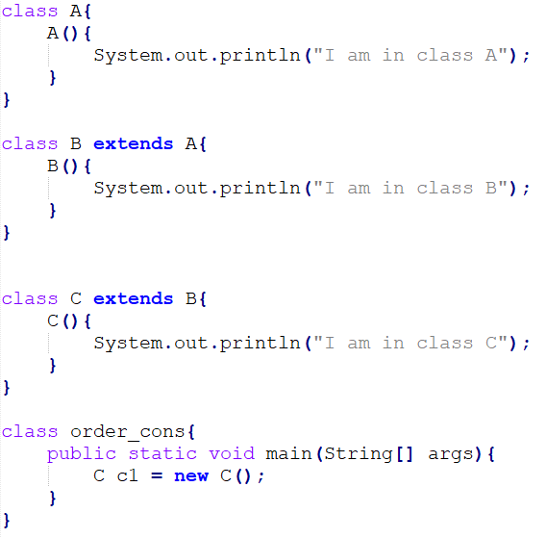
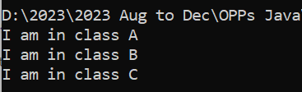
Order of execution of constructor in inheritance

Slide 19
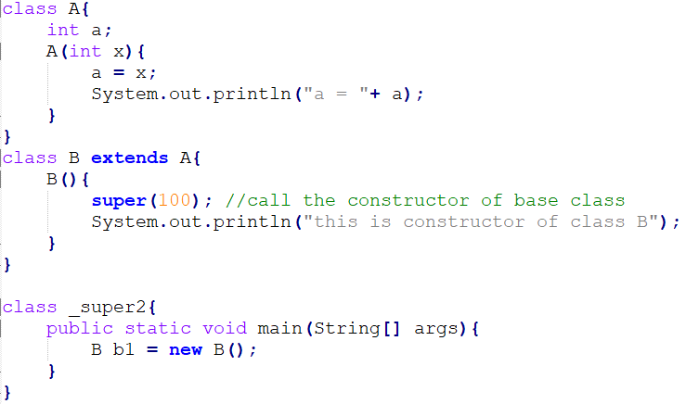

super to call parameterized constructor of base class

Slide 20
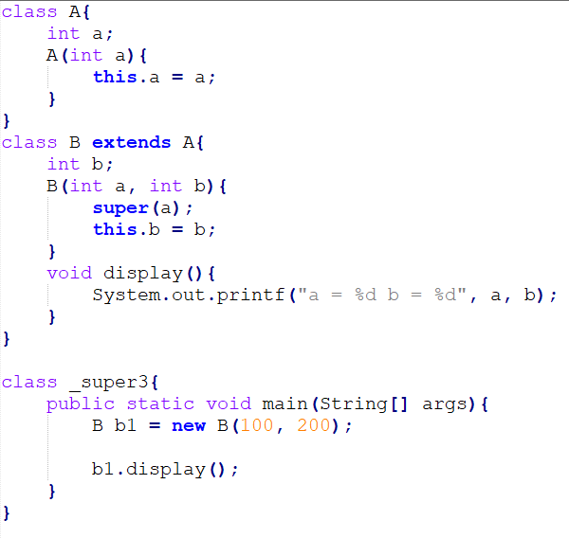

Example super

Slide 21
1. What is the use of the "static" keyword in Java?
a. It indicates that a variable is constant.
b. It indicates that a method belongs to the class rather than an instance.
c. It indicates that a class cannot be instantiated.
d. It indicates that a method cannot be inherited.
b
a
b
c
2. What does the "this" keyword refer to in Java?
a. The current class object.
b. The parent class object.
c. The current method.
d. The base class object.
3. What is the purpose of the "super" keyword in Java?
a. It refers to the current class object.
b. It refers to the parent class object.
c. It refers to the current method.
d. It refers to the base class object.
4. When is it typically necessary to use the "this" keyword in Java?
a. When declaring a new variable.
b. When calling a static method.
c. When there is ambiguity between instance variables and method parameters.
d. When creating a new class.

Slide 22
Method Overriding
In a class hierarchy, when a method in a subclass has the same name and type signature as a method in its superclass, then the method in the subclass is said to override the method in the superclass.
When an overridden method is called from within its subclass, it will always refer to the version of that method defined by the subclass.

Slide 23
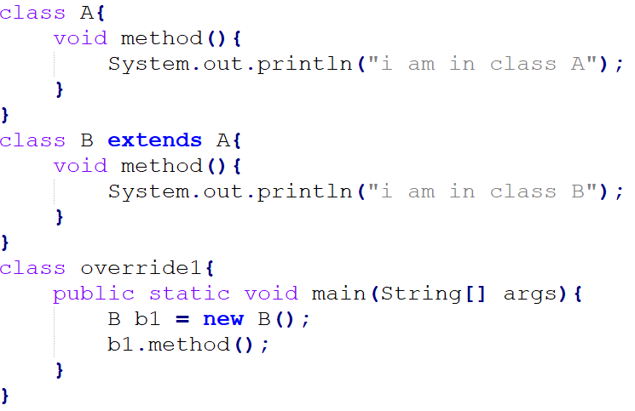
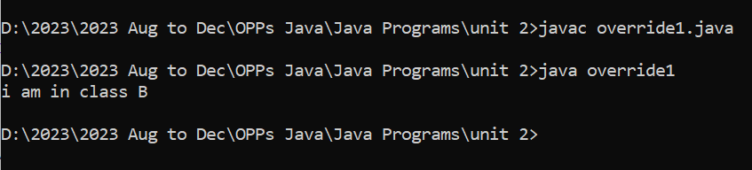

Slide 24
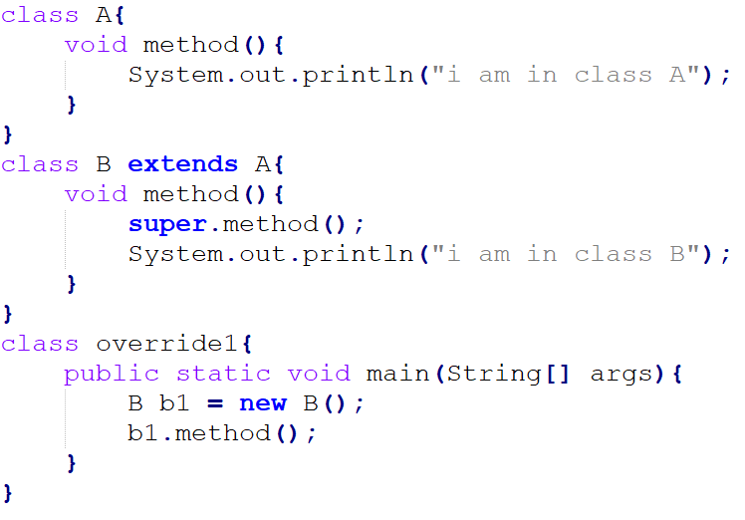
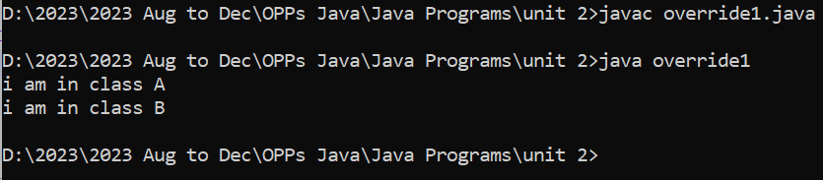
Method Overriding
super can be use to access the superclass version of the method.

Slide 25
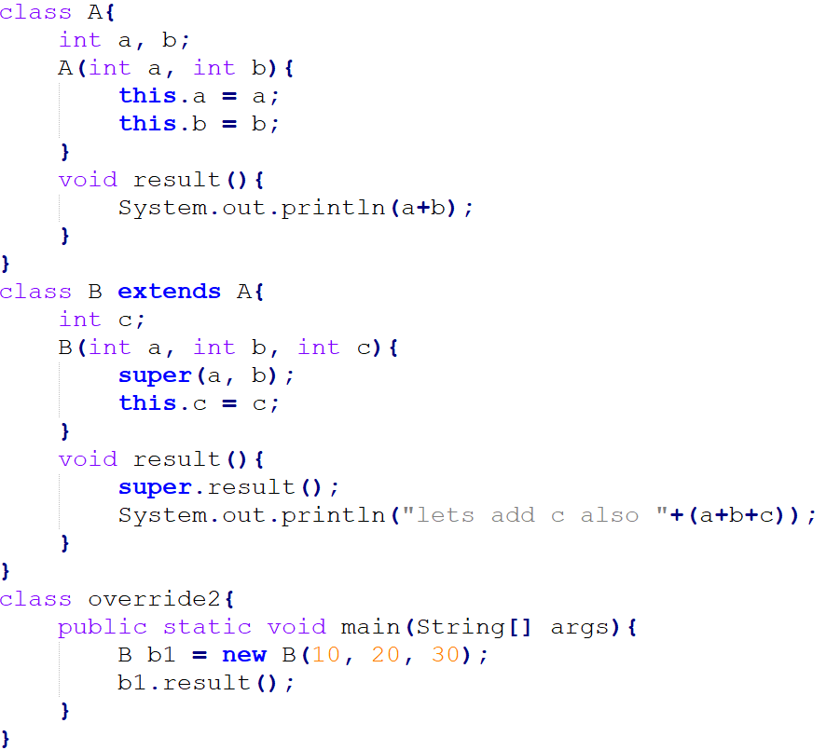
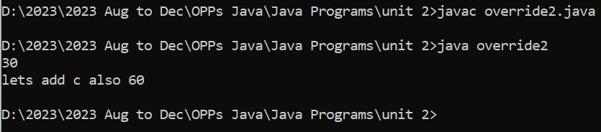
Example

Slide 26
Method Overloading
Method overloading in Java is a feature that allows you to define multiple methods in the same class with the same name but different parameters. The parameters can differ in terms of the number of parameters, the types of parameters, or both.

Slide 27
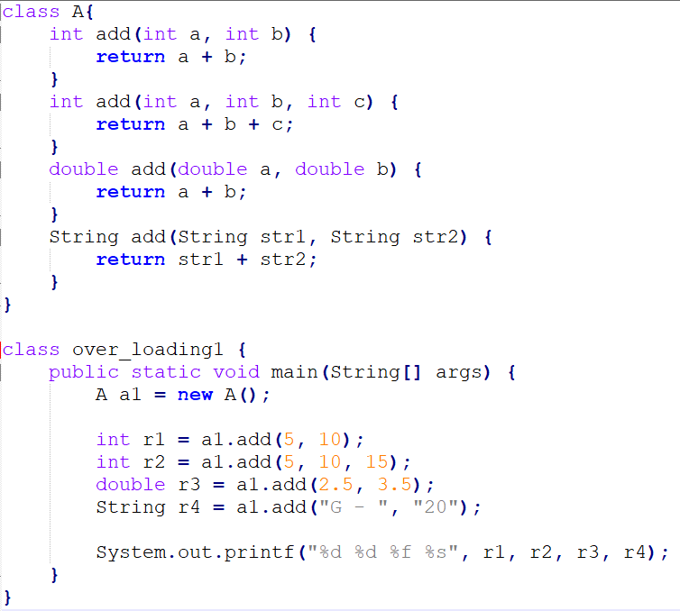


Slide 28
Practice Questions
1. What is the `super` keyword used for in Java?
a) To access the superclass's methods and instance variables
b) To access the subclass's methods and instance variables
c) To create a new instance of a class
d) To call a static method of a class
2. When using `super()` in a constructor, what does it do?
a) Calls the constructor of the superclass with no arguments
b) Calls the constructor of the subclass with no arguments
c) Calls the constructor of the superclass with the same arguments as the subclass constructor
d) Calls the constructor of the subclass with the same arguments as the superclass constructor
3. In a subclass, if you don't explicitly use the `super` keyword to call a constructor, what happens?
a) It results in a compilation error
b) It automatically calls the superclass's default (no-argument) constructor
c) It automatically calls the subclass's default (no-argument) constructor
d) It has no effect on constructors
A
A
B

Slide 29
4. What is the main purpose of using super to access superclass methods in an overridden method of a subclass?
a) To hide the superclass method
b) To override the superclass method
c) To extend the superclass method
d) To call the superclass method and add additional behavior
Answer d) To call the superclass method and add additional behavior
5. To successfully override a method in a subclass, which of the following conditions must be satisfied?
a) The subclass method must have a different name from the superclass method.
b) The subclass method must have the same method name, parameter types, and return type as the superclass method.
c) The subclass method must be marked as final.
d) The superclass method must be marked as private.
Answer b) The subclass method must have the same method name, parameter types, and return type as the superclass method.

Slide 30
6. In method overriding, when you call an overridden method on an object of the subclass, which version of the method is executed?
a) The version of the method defined in the subclass
b) The version of the method defined in the superclass
c) Both versions of the method are executed sequentially
d) None of the above
Answer b) The version of the method defined in the superclass
7. Which keyword is used in a subclass to explicitly call the superclass's overridden method?
a) this
b) super
c) extends
d) override
Answer b) super

Slide 31
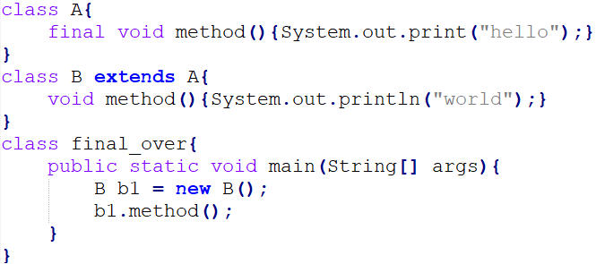
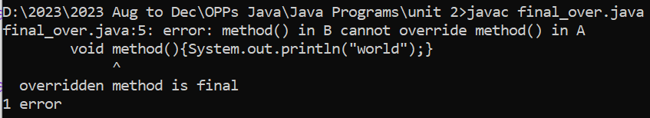
8. What happens if you attempt to override a final method in a subclass?
a) The code will result in a compilation error.
b) The final method in the superclass will be hidden but not overridden.
c) The final method in the superclass will be inherited without any issues.
d) The final method in the superclass will be automatically overridden.
Answer a) The code will result in a compilation error.

Slide 32
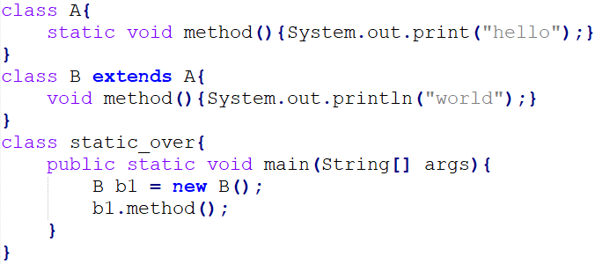
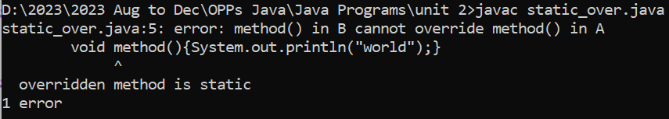
9. Can you override a static method in a subclass?
a) Yes, static methods can be overridden.
b) No, static methods cannot be overridden.
c) It depends on the access modifiers of the methods.
d) Static methods can only be overridden if they are marked as final.
Answer: b) No, static methods cannot be overridden.

Slide 33
References
Schildt, H. (2014). Java: the complete reference. McGraw-Hill Education Group.

